Slide 1
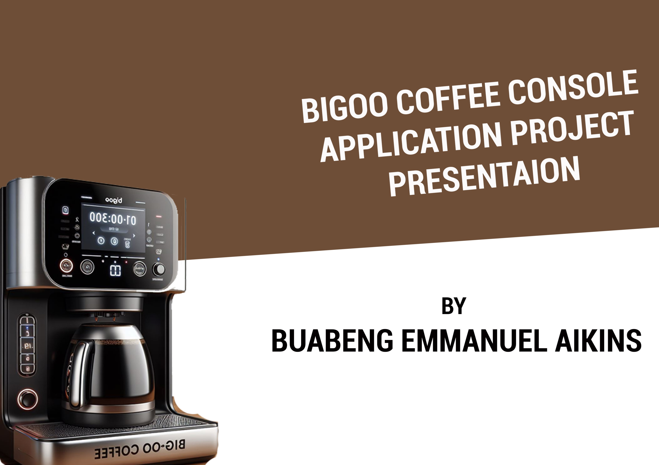

Slide 2
PROBLEM BACKGROUND AND SYSTEM INTRODUCTION
BACKGROUND
Coffee stations, whether standalone businesses or part of larger establishments, often face challenges in managing operations efficiently. Long queues, manual tracking of resources, and limited reporting capabilities can hinder the overall customer experience and business performance. The need for an automated and user-friendly solution is evident.

Slide 3
PROBLEM BACKGROUND AND SYSTEM INTRODUCTION
INTRODUCTION
Bigoo’s coffee machine is a command-line-based coffee station program written in C++. It offers a range of functionalities, including drink purchasing, resource tracking, reporting, and restocking. This system requires two users, operational user and the buyer as a user

Slide 4
USER INTERFACE, FUNCTIONALITY AND DEMONSTRATION
1.0 USER INTERFACE
The user interface provides clear options for users to interact with the coffee machine. It includes features like a loading bar during operations and input validation.
This system get two users interface.
Administration user interface and client user interface.

Slide 5
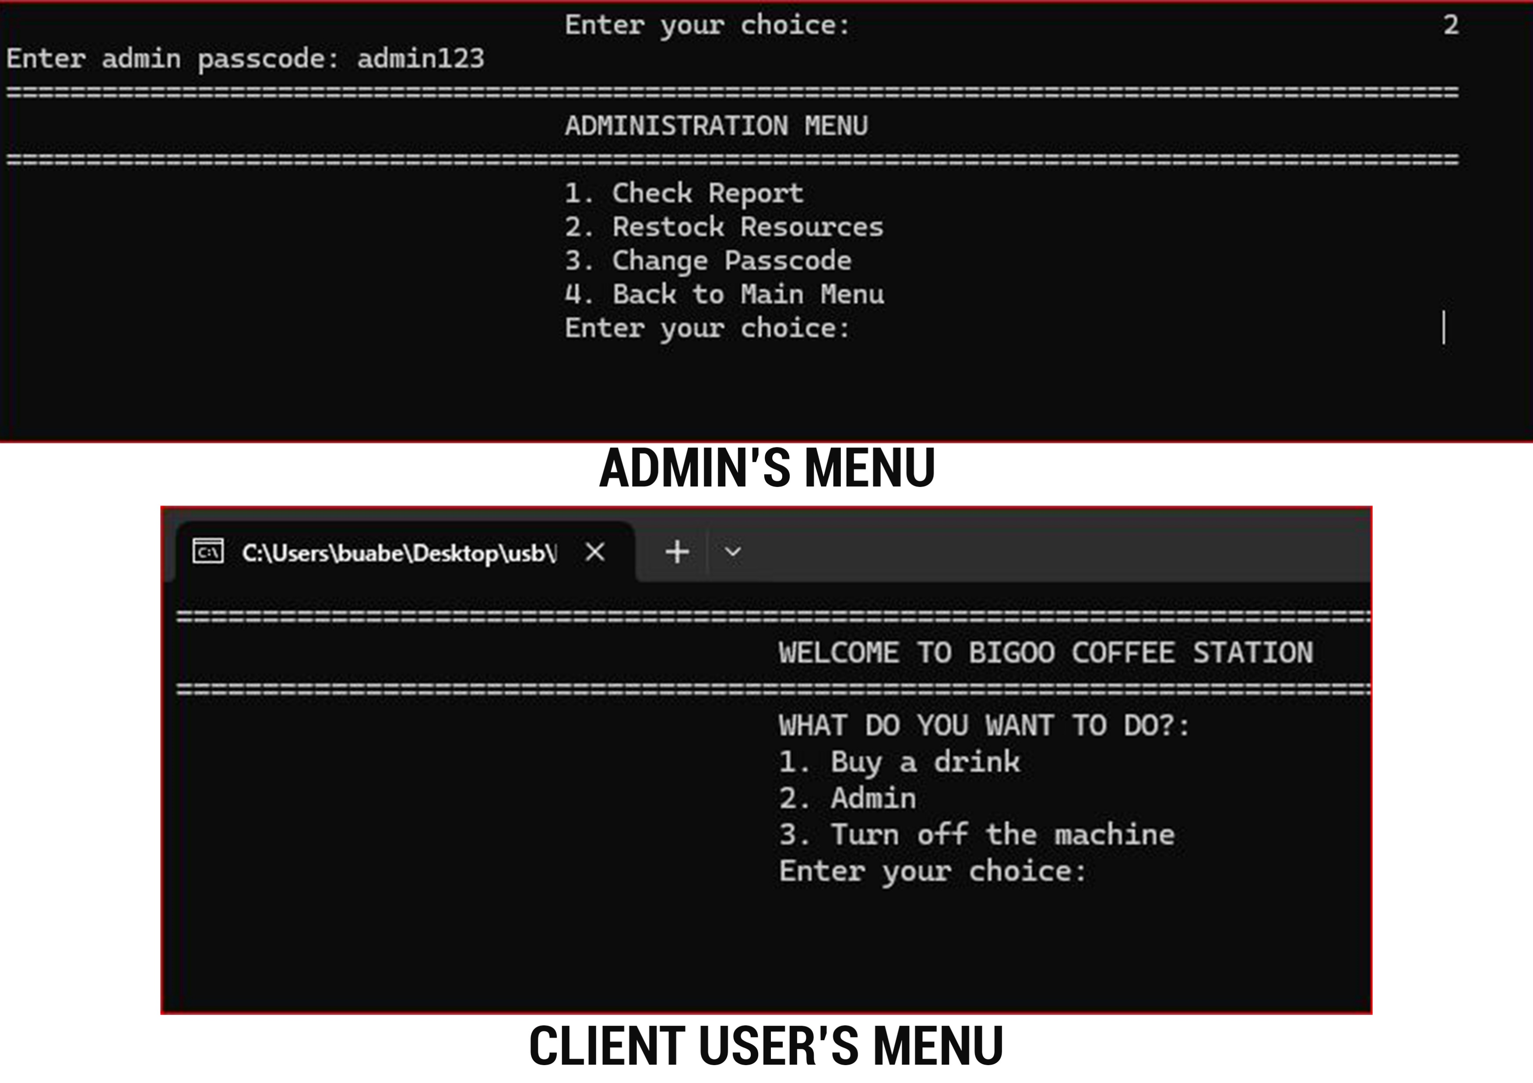
USER INTERFACE, FUNCTIONALITY AND DEMONSTRATION

Slide 6
USER INTERFACE, FUNCTIONALITY AND DEMONSTRATION
1.1 CLIENT USER’S INTERFACE 1.0
The client's user interface offers a clear and user-friendly view to facilitate easy navigation of the system. The client interface includes the following options:
1. Buy Drink
2. Admin
3. Turn off the system

Slide 7
USER INTERFACE, FUNCTIONALITY AND DEMONSTRATION
1.1 CLIENT USER’S INTERFACE 1.2
The user is presented with a "Buy Drink" option, leading to a list of available coffee flavors. After selecting this option, they are prompted to specify the number of different flavors they want to purchase. Following this, the user is asked to input the index of each desired flavor.

Slide 8
USER INTERFACE, FUNCTIONALITY AND DEMONSTRATION
1.1 CLIENT USER’S INTERFACE 1.3
After selecting the desired coffee flavors, the user is prompted to enter the quantity, leading to a total calculation. Subsequent steps involve payment, confirmation, and the issuance of a receipt. Once the receipt is generated, the user is served with their purchased items.

Slide 9
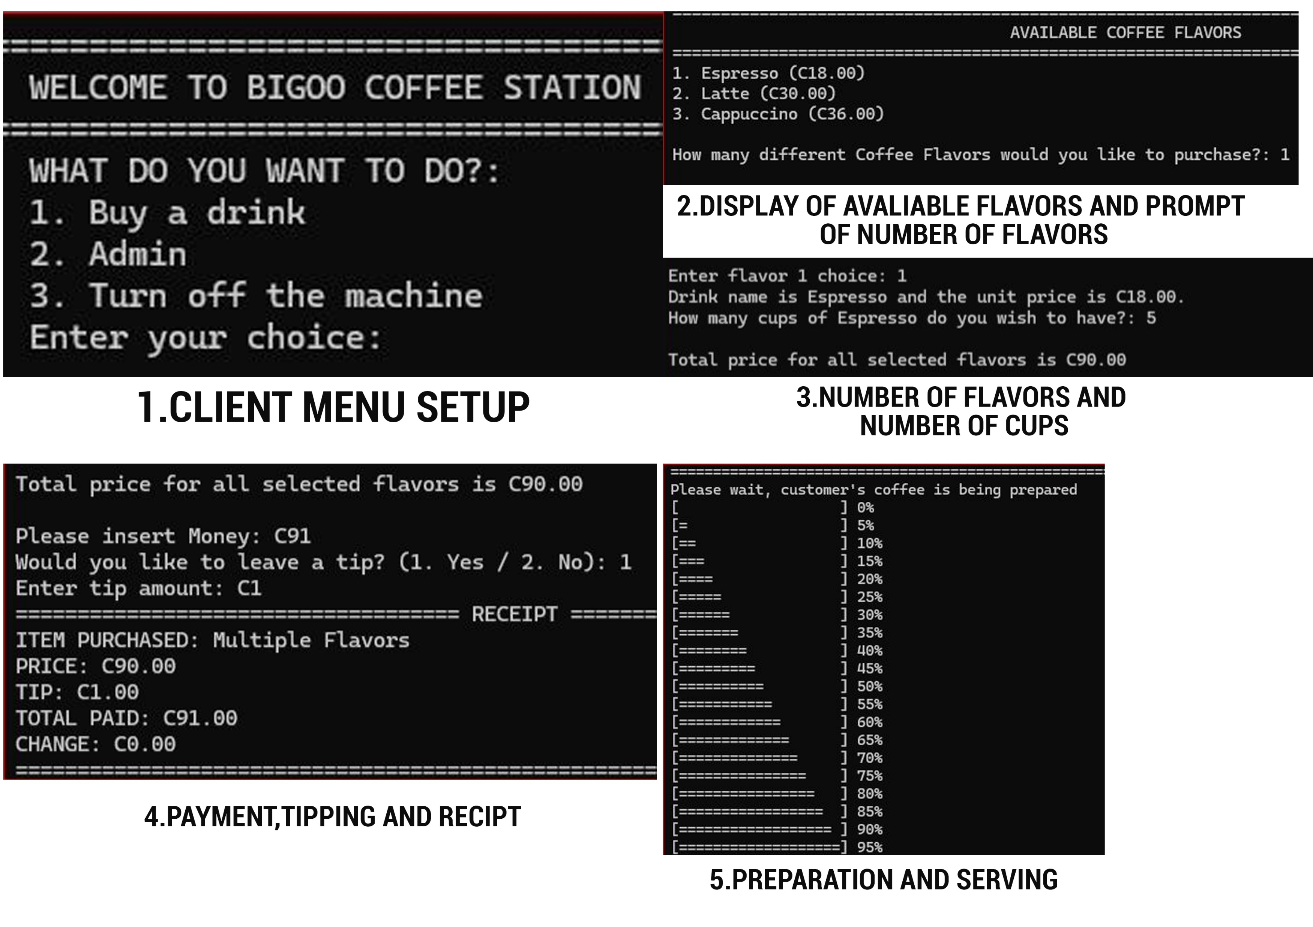
USER INTERFACE, FUNCTIONALITY AND DEMONSTRATION
1.2 CLIENT USER’S INTERFACE 1.4
IMAGE ILLUSTRATION OF THE CLIENT PROCESS

Slide 10
USER INTERFACE, FUNCTIONALITY AND DEMONSTRATION
1.3 ADMINISTRATION USER’S INTERFACE 1.0
The admin interface of the coffee machine system is designed for straightforward and efficient management. It offers four main options: Check Report, Restock Resources, Change Passcode, and Back to Main Menu.
1. Check Report:
- Displays crucial information about current resource levels (water, milk, coffee) and available funds.
2. Restock Resources:
- Enables the administrator to replenish resources by entering the amount to restock for water, milk, and coffee.
- Updates resource levels and records restocking details in the history.

Slide 11
USER INTERFACE, FUNCTIONALITY AND DEMONSTRATION
1.3 ADMINISTRATION USER’S INTERFACE 1.1
3. Change Passcode:
- Allows the admin to modify the security passcode for accessing the admin menu.
- Requires authentication with the current passcode before setting a new one.
- Ensures enhanced security by securely updating the passcode.
4. Back to Main Menu:
- Provides a convenient option to return to the main menu, ensuring seamless navigation.
The described admin functionalities provide efficient oversight and management of the coffee machine system. The modular design prioritizes user-friendly operations, ensuring a smooth and intuitive experience for administrators.

Slide 12
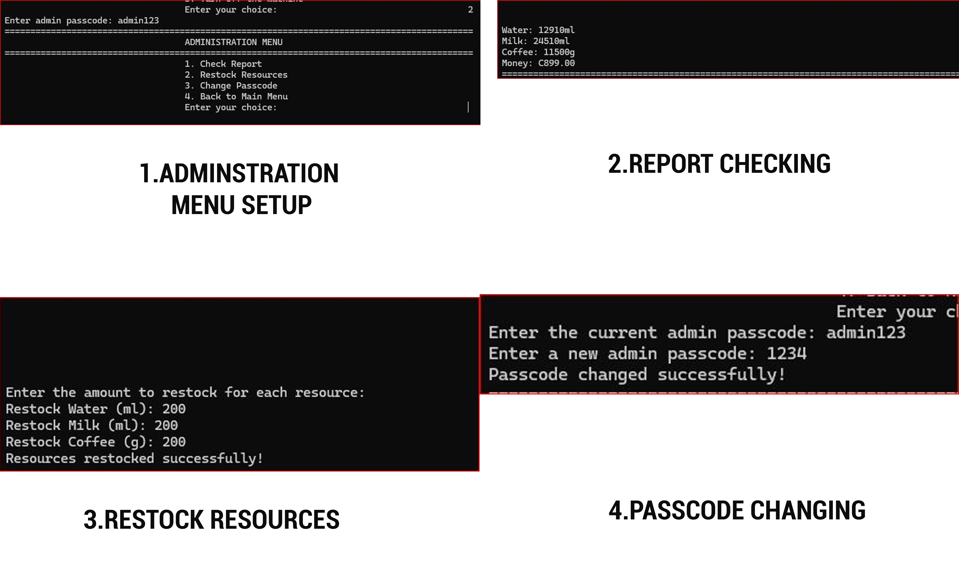
USER INTERFACE, FUNCTIONALITY AND DEMONSTRATION
2.1 ADMINISTRATION USER’S INTERFACE 1.1
IMAGE ILLUSTRATION OF THE ADMINISTRATION PROCESS

Slide 13
THANK YOU FOR YOUR TIME

